Slide 1
Uniform Standards

Slide 2
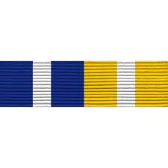
Ribbons
Male Uniform Female Uniform
¼” Above wearer’s left pocket, centered (Male)
6 ¼” Below the intersection of the front and shoulder seams on the right, centered (Female)
Dark colors will be placed inboard
Service stars will be ¼” above the top row of ribbons

Slide 3
Nametags
¼” Above wearer’s right pocket, centered (Male)
6 ¼” Below the intersection of the front and shoulder seams on the right, centered (Female)
Male Uniform Female Uniform

Slide 4
Collar Devices
Rank and J-Bar will be placed 1 ⅞” at the center of the rank or J-bar from the point of the collar, centered.

Slide 5
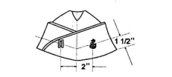
Garrison Covers
Both rank and anchor will be attached 2” from the center and 1 ½” up from the bottom of the cover.
The fouled anchor will be placed on the wearer’s left side, the rank on the right
Only officers and chiefs wear their rank insignia

Slide 6
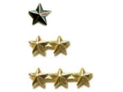
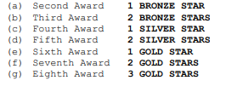
Ribbon Devices
No more than one of each type of ribbon shall be worn
However, ribbons 6, 11, 13, and 15-24 may be awarded more than once but no more than once a semester
When a ribbon is awarded multiple times a star may be placed on the ribbon to represent this.
A cadet can only be awarded the next award of a ribbon once a semester.

Slide 7
Aiguillettes
All aiguillettes earned by cadets in an NJROTC related activities will be worn on the left shoulder.
The only exception is the Leadership Academy aiguillette earned from the Leadership Academy course. The Leadership Academy aiguillette must be worn on the right shoulder.

Slide 8
Aviation Awards
Part 107 Wings will be worn ¼” above the ribbons.
Safety Cert Wings will be worn in place of medals. Note that each cadet may choose to wear either their medals or their wings.
Embry Riddle Eagle will be worn ¼” above the nametag
Eagle
Part 107 Wings
Safety Cert Wings

